Slide 1
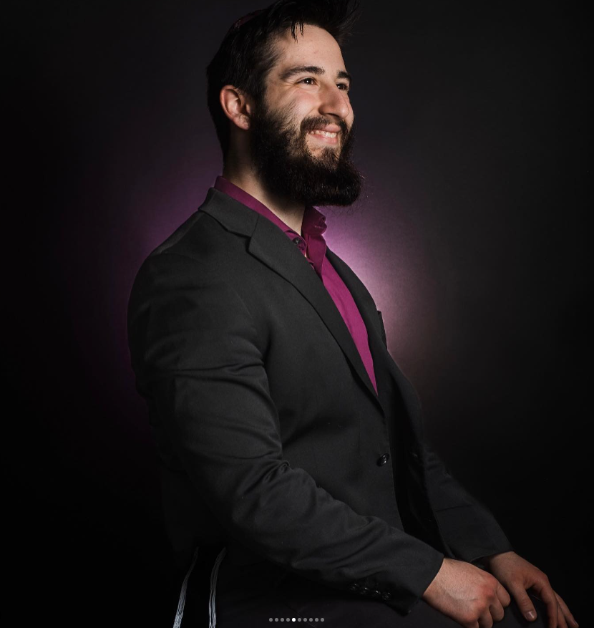
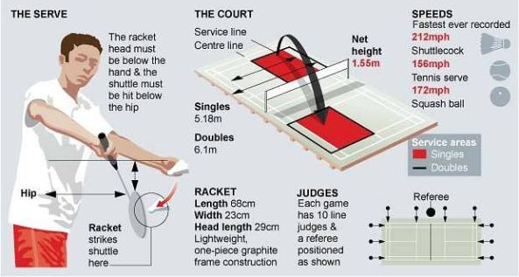
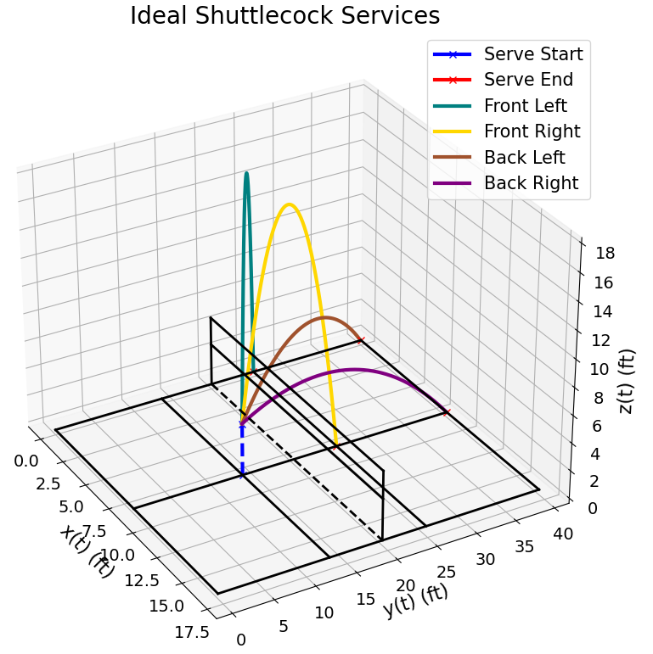
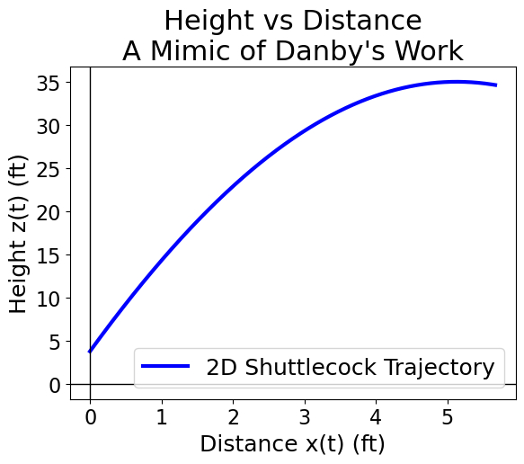
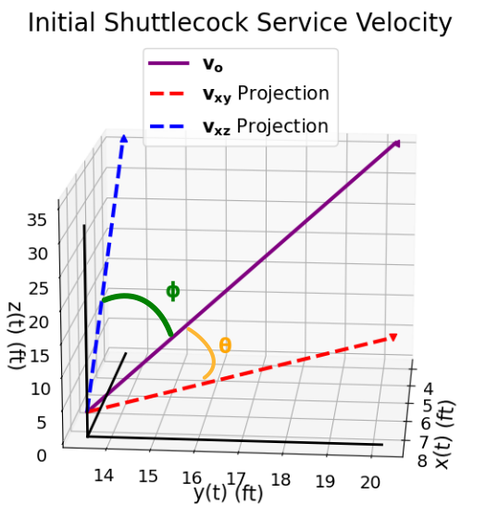
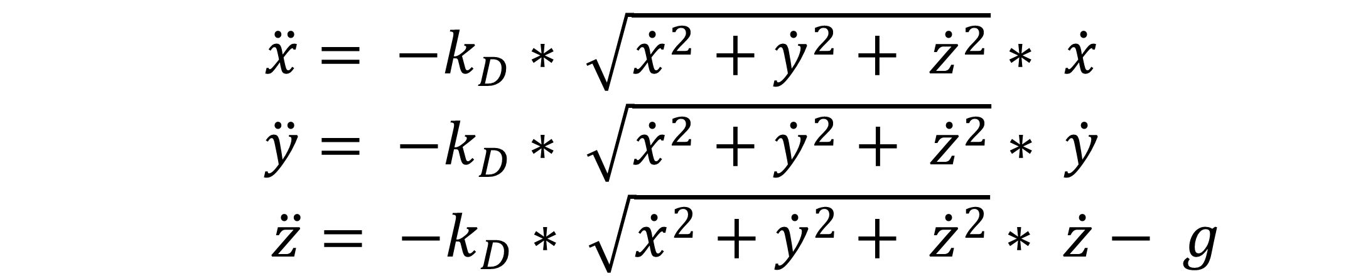
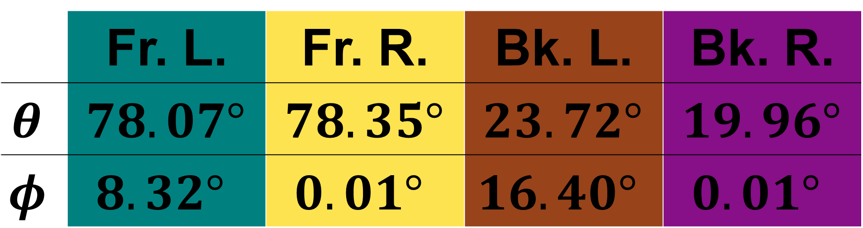
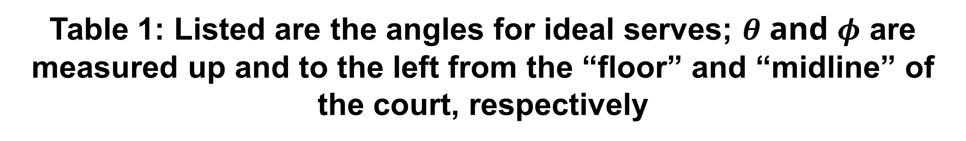
Ideal Badminton Serves
ב"ה
Noah Rosenzweig Department of Physics & Astronomy Ithaca College
Serving Conditions
Results
*Words
Words
Equations of Motion
From Danby, we can find the ODEs to be:
$\ddot{x}= −k_{D}∗ \sqrt{{\dot{x}}^{2}+{\dot{y}}^{2}+ {\dot{z}}^{2}}∗ \dot{x}$
$\ddot{y}= −k_{D}∗ \sqrt{{\dot{x}}^{2}+{\dot{y}}^{2}+ {\dot{z}}^{2}}∗ \dot{y}$ $\ddot{z}= −k_{D}∗ \sqrt{{\dot{x}}^{2}+{\dot{y}}^{2}+ {\dot{z}}^{2}}∗ \dot{z}− g$
Figure 2: Ideal Shuttlecock Services; initial velocity of $10$ ft/s
 | Fr. L. | Fr. R. | Bk. L. | Bk. R.
$$θ$$ | $$78.07°$$ | $$78.35°$$ | $$23.72°$$ | $$19.96°$$
$$φ$$ | $$8.32°$$ | $$0.01°$$ | $$16.40°$$ | $$0.01°$$
Table 1: Listed are the angles for ideal serves; $θ$ and $φ$ are measured up and to the left from the “floor” and “midline” of the court, respectively
Conclusion
If a beginner makes one of the four most ideal badminton services whilst throwing off their opponent, the shuttlecock will land within bounds, scoring a point!
References
See Github for full References and other related items
Figure 1: Mimicking J.M.A. Danby, a 2D trajectory graph of a shuttlecock’s flight path with an initial velocity of 50 ft/s, 80° above the x-axis
Acknowledgments
I would like to thank Dr. Colleen Countryman for all her guidance and help on this project, alongside my previous professors for building my coding knowledge, skills, and resources.
Additionally, I would like to thank Jupyter and Spyder IDEs for their ease of use and functionalities.

